Slide 1
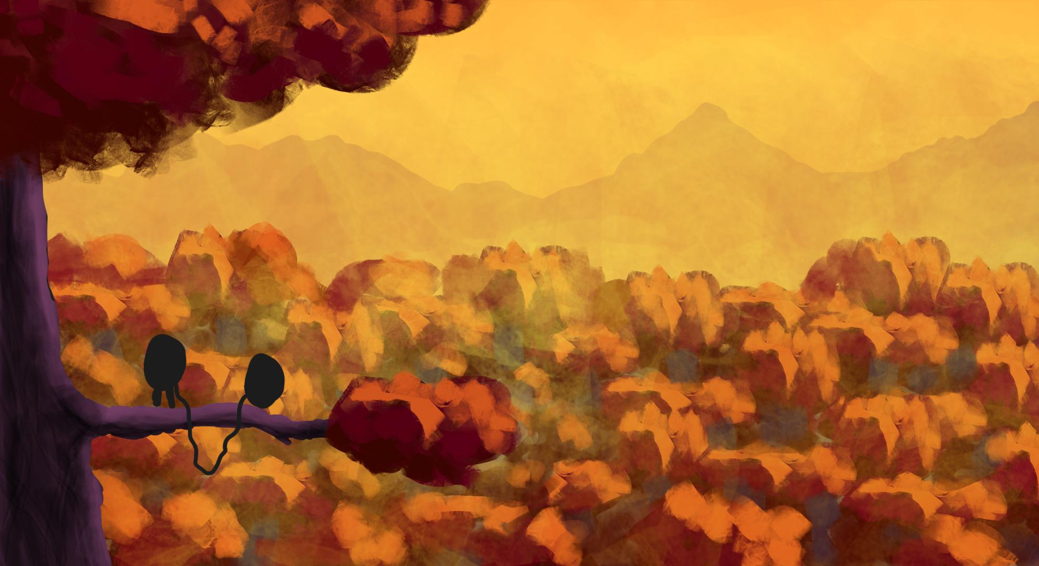




BACK HOME
Ugo Aurélien Timothée Aymeric Thomas Belfiore Demey Degli Innocenti Manceau Rodriguez
Le Cnam-Enjmin, une école du campus de l’Image

Slide 2
INTENTIONS
Easy to learn
Hard to master
Couch coop
2D plateformer with rope mecanic

Slide 3
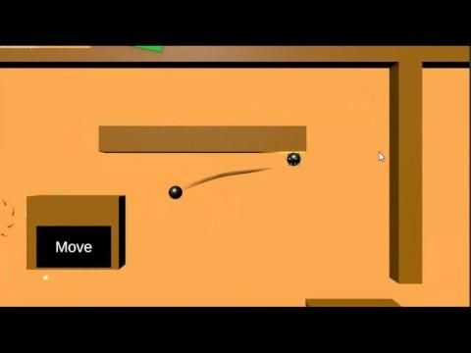
PHYSICS

Slide 4
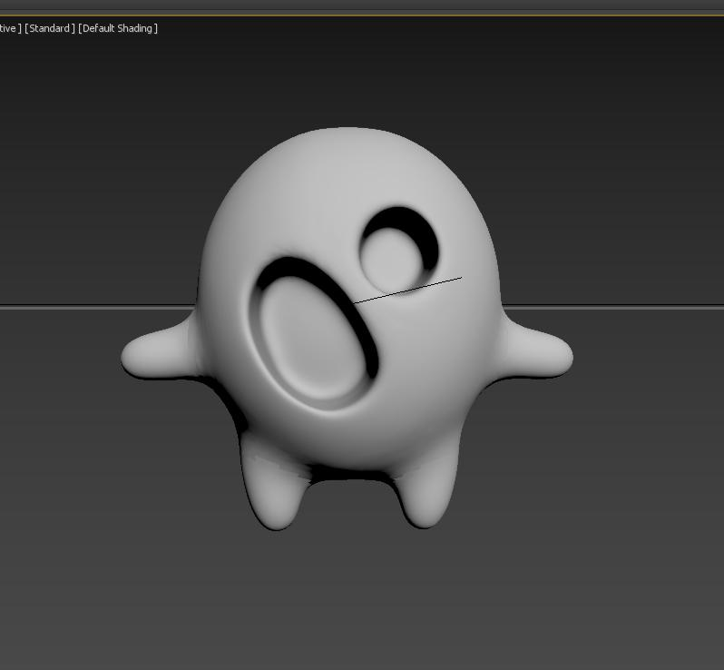
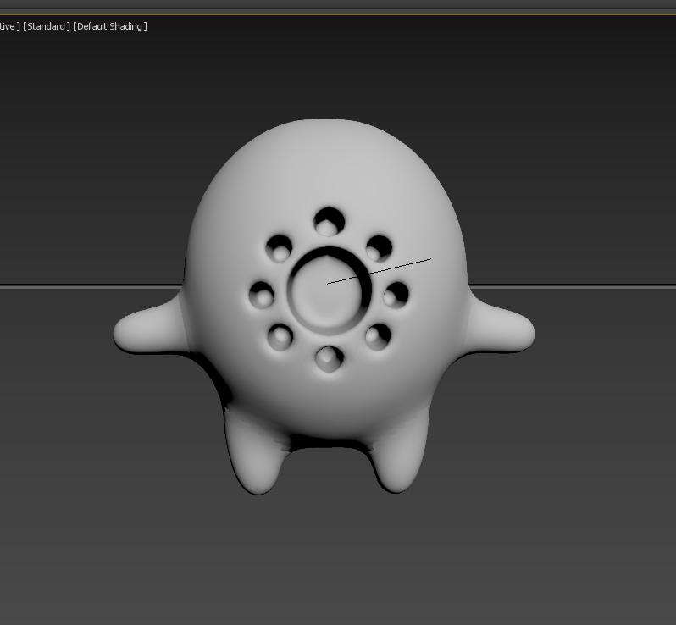
GRAPHIC DESIGN
2D environment
3D characters
Magical/Fairy world
Colorful universe
Exaggerated proportions
Pervasive nature

Slide 5
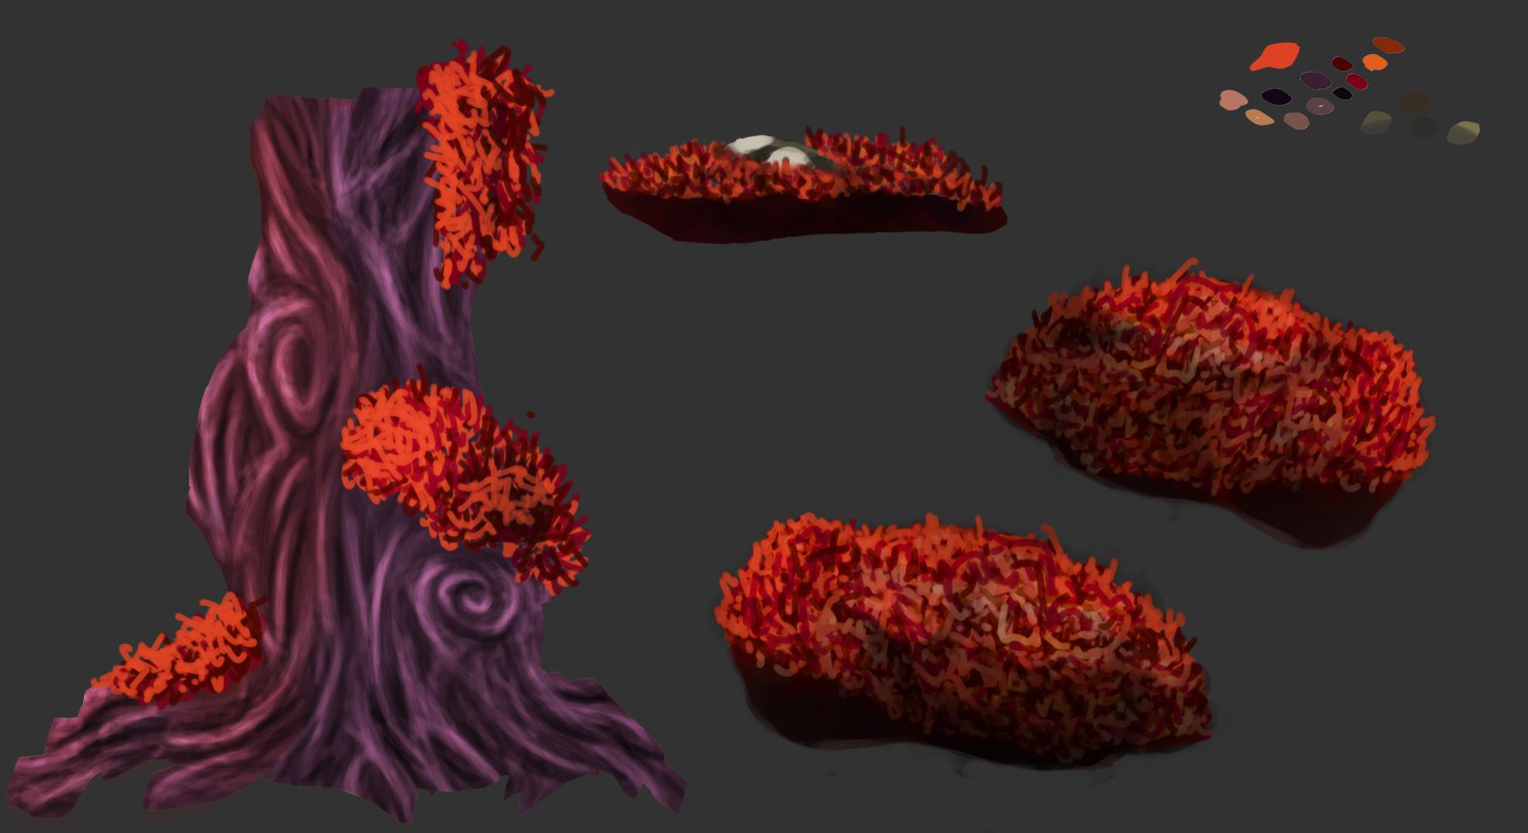
GRAPHIC DESIGN
GRAPHIC DESIGN
aspect des personnages
corde = presque plus important que les persos
Forest ambience
Oversized nature
Warm color palette
Notes:
Conception des Personnages
Modélisation sur Zbrush
Importation dans 3dsmax
Rigging et skinning
Animations

Slide 6
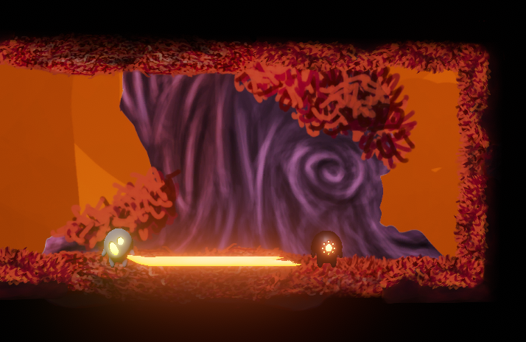
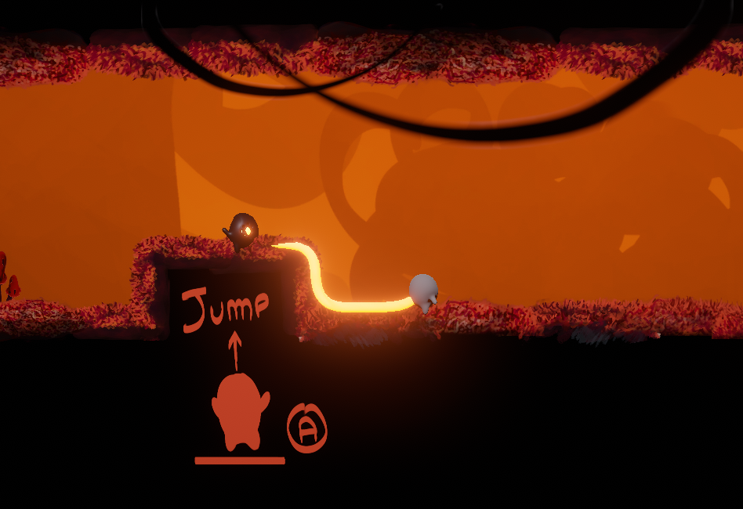
GRAPHIC DESIGN
THE ROPE
Notes:
Conception des Personnages
Modélisation sur Zbrush
Importation dans 3dsmax
Rigging et skinning
Animations

Slide 7
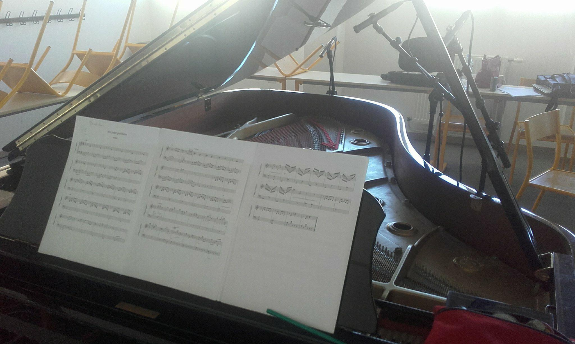
Music
Poetic natural ambience
inspiration : classical music
small ensemble : intimate ambience
References : Seasons After Fall
Composition and recording of a trio : viola, clarinet and piano

Slide 8
Sound Design
Natural living environment
Small creatures
Dynamic gameplay

Slide 9
PRODUCTION
Desire of precision
External opinion
Animate our discussions
Make the team job’s easier
Notes:
equipe+merci+trailer

Slide 10
CONCLUSION
Come find us in the atrium
Introducing the team
Thank you
Here’s the trailer
Notes:
equipe+merci+trailer

Slide 11

TRAILER

Slide 12
BACK HOME
Ugo Aurélien Timothée Aymeric Thomas Belfiore Demey Degli Innocenti Manceau Rodriguez
Le Cnam-Enjmin, une école du campus de l’Image

